Slide 1
COPADS
#08– Network Security
IFEOLUWATAYO IGE

Slide 2
OUTLINE
Network Security Goals
Encryption-Decryption
Cryptanalysis
Encryption-Types
Hashing
Message Authentication Code (MAC)

Slide 3
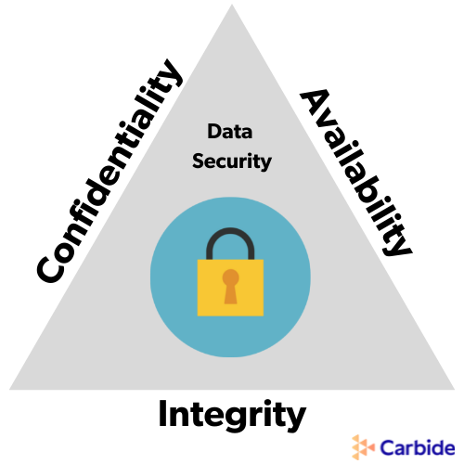
Network Security Goals
The following goals must be achieved when data is accessed or transferred through network systems:
Confidentiality /Privacy- Data must be kept secret or private.
Accessibility/Availability- system resources and files should be available to genuine users whenever needed.
Integrity (No Replayability)– maintaining the accuracy and consistency of data. Unauthorized persons or hackers should not change data.
Authentication- Identities of senders/receivers should be proven before granting access to resources (preventing falsehood/pretense)
Authorization- individual access rights to modify data
Non-Repudiation: a mechanism that prevents the denial of the message content sent through a network. The sender can not deny a message sent.
Notes:
Confidentiality(Privacy) - the state of keeping or being kept secret or private. Ensuring that only people who are supposed to access data can access it
Authentication – the act of proving identity to access resources
Integrity - Integrity, in terms of data and network security, is the assurance that information can only be accessed or modified by those authorized to do so. Ensuring there is no breach of confidentiality
No Replayability – the protection from someone playing back a thing to make it seem authentic
Availability – ensuring that resources are availability when they are supposed to

Slide 4
ENCRYPTION-DECRYPTION
When Alex sent messages to Blake, he didn't trust his messengers. So he replaced every A in his messages with a D, every B with an E, and so on through the alphabet. Only someone who knew the “shift by 3” rule could decipher his messages.
Alex’s initial message is called PlainText (P)
His eventually sent message is called CipherText (C)
The process of converting from plaintext to ciphertext is known as enciphering or encryption
Converting the ciphertext to the plaintext is deciphering or decryption
The shift by 3 rule is called the Caesar cipher.

Slide 5
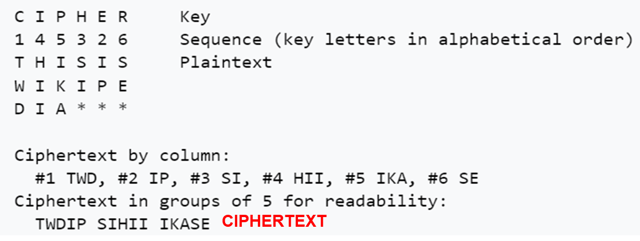
Encryption-decryption
A cipher is an algorithm for encrypting and decrypting data
For Encryption ; C = E(P,K_{E}) where: P is the plain text; K_{E} is the Encryption key; C is the ciphertext
E is the encryption function generated by a cipher.
Decryption: P = D(C, K_{D}); Decryption Key is K_{D}
There are two categories of ciphers:
Transposition Cipher: Plaintexts can be rearranged into a ciphertext using a key, scrambling the order of characters like the shuffled pieces of a jigsaw puzzle. If "THIS IS WIKIPEDIA“ is the plain text:
More is discussed in the cryptography class!
Substitution Ciphers: This involves writing out the alphabet in some order to represent the substitution
https://en.wikipedia.org/wiki/Transposition_cipher

Slide 6
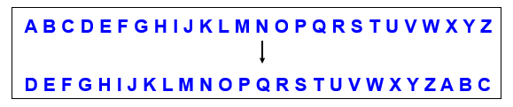
Substitution Ciphers-Types
1. Caesar cipher
The set of plain text characters is replaced by other characters, symbols, or numbers.
Each alphabet in the message is replaced by three places down (shift by 3).
For instance, if a plain text is EDUCBA. What is the Ciphertext?
The ciphertext is HGXFED.
It is a very weak technique for encryption.
This is very easy to break!

Slide 7
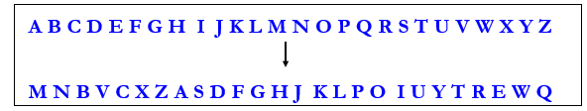
2. Monoalphabetic cipher
Any letter can be substituted for any other letter.
You have to determine a substitute for each letter. For example:
There are 26! Pairs of letters that can be done
Using the Brute Force approach to fix the substitutes would be too time-consuming
Example: encrypt- I LOVE YOU

Slide 8
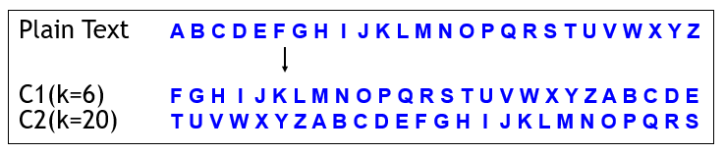
Types of Ciphers
3. Polyalphabetic cipher
Follows a sequence with respect to the size of k.
Developed by Vigenere
Example: encrypt- I LOVE YOU

Slide 9
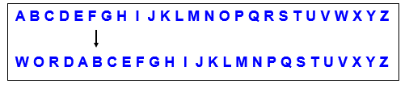
Types of Ciphers
4. Keyword Cipher
Select a keyword and then shift the alphabet
For instance, if the key is” word” we will shift all the letters by four and remove the letters w, o, r, & d from the encryption
We have to ensure that the mapping is one-to-one
no single letter in plain text can map to two different letters in cipher text
no single letter in cipher text can map to two different letters in plain text
Example: encrypt- I LOVE YOU

Slide 10
CRYPTANALYSIS
Cryptanalysis is the “smart” approach to breaking ciphers.
The attacker uses knowledge of the ciphers, as well as expected patterns in ciphertext and plaintext to find unknown information (e.g. keys or plaintext).
2 broad known attacks namely:
Generic known plaintext attack on a cipher
Generic known ciphertext attack on a cipher

Slide 11
Generic known plaintext attack on a cipher
Harry knows a PlainText and its corresponding CipherText
Suppose a key is a k-bit number
Harry tries to encrypt P using every possible key from 0 to 2^{k}−1 through a brute force
Harry stops when he finds a key that encrypts P to C
The attack takes 2^{k} encryptions
His goal is to get the secret key K that would allow him to decrypt any further messages

Slide 12
Generic known ciphertext attack on a cipher
Harry knows CipherText but does not know the corresponding PlainText and the key.
Harry tries to decrypt C using every possible key from 0 to 2^{k}−1
Harry stops when he finds a key that decrypts C to an intelligible plaintext
The goal is to recover as many intelligible plaintext messages as possible and (preferably) to guess the secret key.
Once the key is gotten, it will be possible to decrypt all the other messages that have been encrypted by this key.
The attack takes about 2^{k} encryptions

Slide 13
Categories of Encryption
There are two major categories of encryption:
Symmetric encryption uses a single key earlier shared between the sender and the receiver(shared secret key)
Asymmetric encryption uses a public key and a private key to encrypt and decrypt messages (public key encryption)

Slide 14
Symmetric Encryption
Alex encrypts P using K which yields C. He then sends C to Blake
Blake decrypts C using K which yields P
Harry the hacker doesn't know K, so he can't decrypt the messages
Drawbacks?
Secret key generation – This is computationally expensive.
Key Exchange/ Establishment – This is initially required between Alex and Blake
Security Issues-The key has to be communicated in a very secure method
The same secret key is used for all messages to avoid computational costs. Harry can easily have access to all messages once he gets the key.
Trust issues among key parties

Slide 15
Symmetric Encryption Methods
1. STREAM CIPHERS
A stream cipher is a symmetric key cipher that encrypts plain text one digit at a time.
A selected key is an input to a pseudorandom number generator that produces a stream of random bit numbers called Keystream.
Each plaintext bit is combined one at a time with the corresponding bit of the keystream using the bitwise exclusive –OR (XOR) operation to get the ciphertext.
The main advantages of a stream cipher :
It is faster than block ciphers
They are useful for applications with little computational resources, e.g., cell phones or other small embedded devices.
A prominent example of a stream cipher is the A5/1 cipher, which is part of the GSM mobile phone standard and is used for voice encryption
Stream ciphers are sometimes also used for encrypting Internet traffic, especially the stream cipher RC4 (which has been broken unfortunately).
Other popular stream ciphers are SALSA20, https://en.wikipedia.org/wiki/Salsa20
CHACHA20 https://cyberw1ng.medium.com/understanding-chacha20-encryption-a-secure-and-fast-algorithm-for-data-protection-2023-a80c208c1401

Slide 16
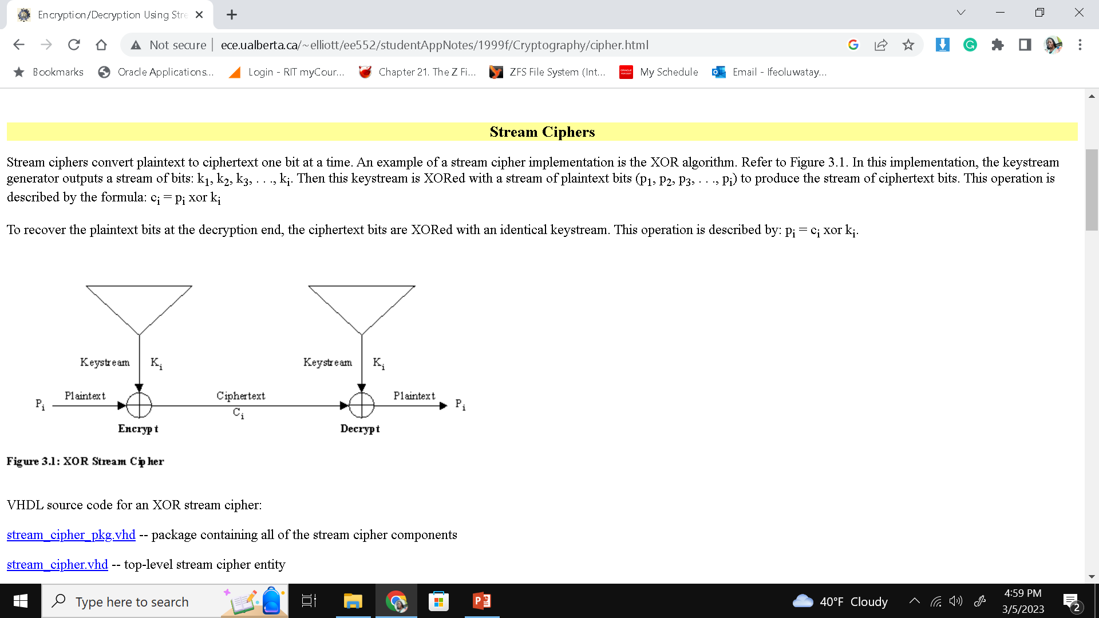
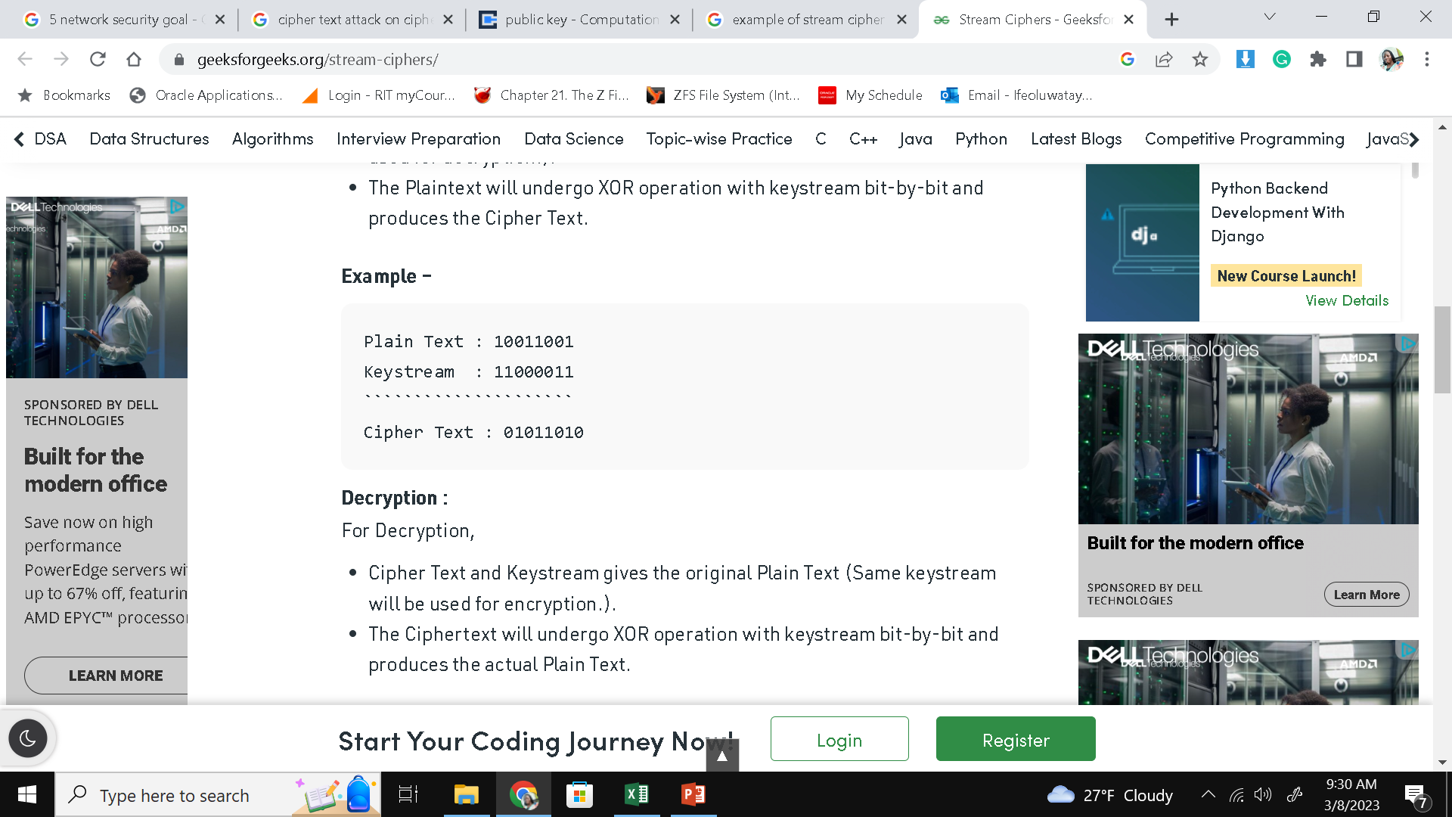
Stream Algorithm
Keystream generator algorithm
Inputs:
key K
And a nonce N (also called Initialization Vector) which may be random or incremented.
K and N are known by the sender and receiver
Output: keystream S — a sequence of random bits, of arbitrary length
To Encrypt plaintext P,
Ciphertext C = P ⊕ S (exclusive-or)
Decryption
Plaintext P = C ⊕ S (exclusive-or)
Changing the key or the nonce or both yields a completely different keystream

Slide 17
Back to Our Example
If Harry gets a hold of P and C, he can recover the keystream: S = P ⊕ C
If Alex and Blake use the same keystream for additional messages, Harry can decrypt those messages
Therefore, every message must use a different keystream which means a different nonce for every keystream or different keys!

Slide 18
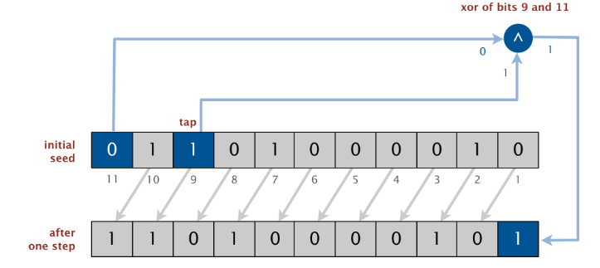
Keystream Generator algorithms
True Random number generator- uses an unpredictable, non-deterministic means to generate numbers (like atmospheric noise, temperature, etc.) that humans cannot control.
Pseudorandom number generator- uses mathematical algorithms to produce a certain sequence of numbers that will appear random. pseudorandom sequences are produced in a deterministic way
Linear Feedback Shift Registers (LFSRs)- is a register of bits that performs discrete step operations that:
shifts the bits one position to the left and
replaces the vacated bit by the exclusive or(XOR) of the bit shifted off and the bit previously at a given tap position in the register
Details on these algorithms in Cryptography class!

Slide 19
2. Block Cipher
Block cipher breaks down plaintext messages into fixed-size blocks (each block consists of some number of bits) and converts them into ciphertext using a key schedule.
Given an initial key K, a key schedule (that consists of several subkeys) must be generated.
There are two major ways to structure a block cipher:
Substitution-Permutation Network (SPN) ciphers
Feistel Ciphers

Slide 20
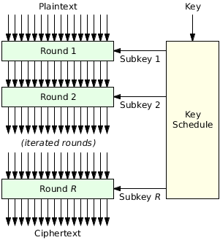
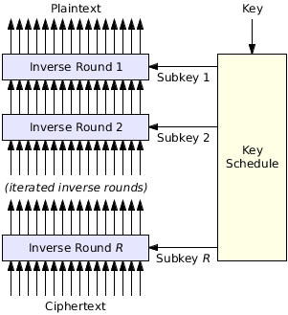
Block Cipher
Encryption:
Input: plaintext P, key schedule (set of keys K_{i} )
Output: ciphertext C
Decryption:
Input: Cipher text key schedule (set of keys K_{i} )
Output: Plaintext P

Slide 21
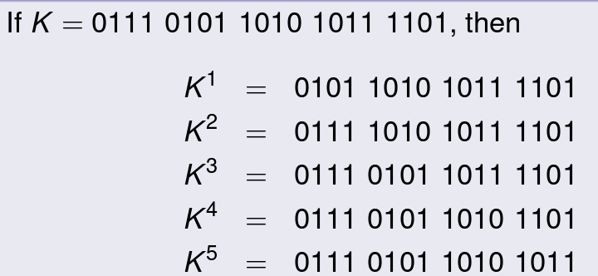
Key Schedule
A key schedule consists of subkeys. The greater the number of subkeys/rounds, the more secure the block cipher.
Although there are several methods for generating subkeys which are discussed in the cryptography course, we can look at an example.
Assume we need to perform 5 rounds to encrypt a plaintext.
If each round requires a 16-bit round key but the key is 20 bits;
We can group the 20bits in groups of 4bits
We remove the k^{th} group for round k.

Slide 22
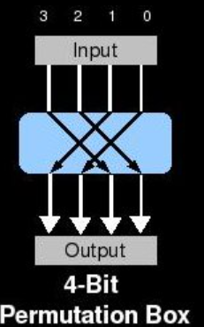
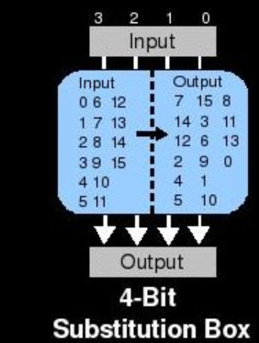
Block Cipher: Substitution-Permutation Network (SPN)
The SPN accepts each subkey and plaintext at each round.
The following steps are taken at each Round during encryption:
1. Key Mixing: This is done by XORing the plain text with the subkey for that round. It is expected that the plain text (divided into blocks) is of the same length as the subkey.
2. Adding Diffusion by Permutation: The objective of diffusion is to spread information around in the ciphertext. The positions of bits could be switched.
3. Adding Confusion by Substitution: This takes input from the permutation step and checks a lookup table to determine the output. In the decryption routine, this lookup table is reversed Substitution functions must be reversible to allow decryption.
This cipher is used by Advanced Encryption Standard (AES).

Slide 23
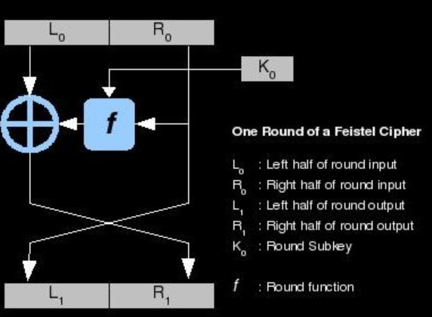
Block Cipher: Feistel
This method combines the SPN and XOR operations for encryption and decryption.
The following steps are taken at each round:
Plain text is split into two halves: left and right.
The right side is combined with a subkey from a key schedule by key mixing, substitution, and permutation.
The output of the round is then XOR'd with the left half; this produces the next round's right half.
The next round's left half is simply the current round's right half before the SPN methods were performed.
This cipher is used by US Data Encryption Standard (DES algorithm)

Slide 24

Advanced Encryption Standard (AES)
AES is a symmetric encryption algorithm established by the U.S. National Institute of Standards and Technology (NIST) in 2001. It was developed by two Belgian cryptographers: Joan Daemen and Vincent Rijmen.
It has been adopted by the U.S. Government
AES supports different key lengths of 128, 192, or 256 bits
It is highly secure as it is widely used by governments, organizations, and individuals to protect sensitive information.
The strength of AES lies in its key size, which provides an astronomically large number of possible key combinations (2^256) that would need to be tested to break the encryption
It would take an infeasible amount of time to try all possible combinations and break AES 256-bit encryption through a brute-force attack. The computational resources and time required to crack it are considered beyond the capabilities of current technology.
AES-256 has not been cracked as the last time I checked

Slide 25
Pro of the Block Cipher:
High diffusion. (Diffusion means that if we change a character of the plaintext, then several characters of the ciphertext should change, and similarly, if we change a character of the ciphertext, then several characters of the plaintext should change)
Con:
Slower encryption speed since the entire block must be captured for encryption/ decryption

Slide 26
HASHING
A Hashing function is a mathematical algorithm that converts data of arbitrary size into a fixed-size output. The output is a ciphered text called a hash value which is always unreadable.
Hashing can be efficiently executed but extremely difficult to reverse.
Hash is not the same as encryption. Encryption is a two-way function as the plaintext can be encrypted into ciphertext and decrypted back into plaintext using a unique key. Hashing is irreversible.
Simple Example:
In the bank, you apply for a credit card.
You create a password to help you access your account.
The bank system does not save your password. It however runs the password through a hashing algorithm and then saves the hash as your password.
Every time you attempt to log in to your account, the bank system compares the password you type in with the hash it has saved. When the two hash values are equalw, you get authorization to access your bank account.
Hashing is used to:
To verify data integrity.
For proper authentication.
To store sensitive data.

Slide 27
Properties of a Hashing Function
Deterministic - a hash function H should consistently map a given input m to a hash value h
One-way function (pre-image resistance) – We can’t reverse a hash function back to the original password. For a hash function H, if given any hash value h, it is computationally infeasible to find an input m such that H(m) = h.
Collision resistance – given a hash function H, it should be computationally infeasible to find two inputs m and m’ such that m ≠ m’ and H(m) = H(m’).
Target collision resistance (2nd pre-image resistance)- given a hash function H and any input m, it should be computationally infeasible to find another input m’ such that m’ ≠ m and H(m) = H(m’).
Hash Speed- a hashing algorithm should compute hash values rather quickly.
Avalanche effect — this property requires that a change in just one bit of the input data should result in a large change in the output.

Slide 28
U.S. Government Standard Hash Algorithms
SHA-1: 160-bit
SHA-2: 224-, 256-, 384-, or 512-bit
Federal Information Processing Standards Publication (2015). Secure Hash Standard (SHS). August 2015. http://nvlpubs.nist.gov/nistpubs/FIPS/NIST.FIPS.180-4.pdf
SHA-3: 224-, 256-, 384-, or 512-bit
Federal Information Processing Standards Publication 202. SHA-3 Standard: Permutation-Based Hash and Extendable-Output Functions. August 2015. http://nvlpubs.nist.gov/nistpubs/FIPS/NIST.FIPS.202.pdf

Slide 29
SHAs
SHA-1 is broken — if there is any attack faster than brute force/what we expect of an ideal primitive. Broken does not mean that there are practical attacks.
Even when there were no known collisions in SHA-1, the collision resistance of SHA-1 is called broken, because there is a theoretical attack that can find collisions using 2⁶³ operations fewer than the brute force 2⁸⁰ operations to SHA-1
SHA-2 is not (yet) broken, but its algorithms are similar to SHA-1
SHA-2: 256 is widely used in the Bitcoin blockchain
SHA-3 is not broken, and its algorithms are completely different from SHA-1 and SHA-2
Keccak-256, (a variant of SHA3-256 with some constants changed) is used in the Ethereum blockchain
BLAKE2 / BLAKE2s / BLAKE2b is a family of fast, highly secure cryptographic hash functions, providing calculation of 160-bit, 224-bit, 256-bit, 384-bit, and 512-bit digest sizes, widely used in modern cryptography.
https://cryptobook.nakov.com/cryptographic-hash-functions/secure-hash-algorithms

Slide 30
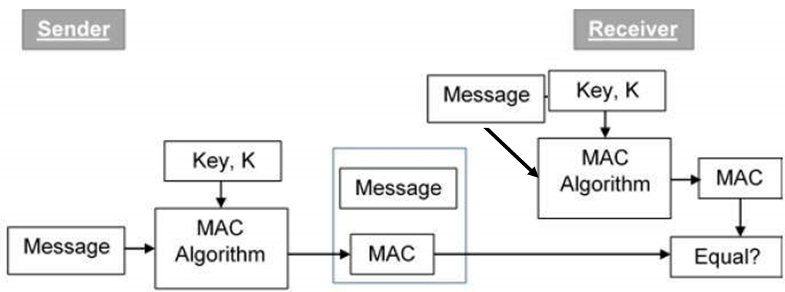
Symmetric Encryption: MAC
MAC- Message Authentication Code is used to authenticate the origin and nature of a message
MAC ensures that the message from the correct sender has not been changed; the data transferred over the network is legitimate and does not contain harmful code.
The sender and receiver of a message must agree on the same key before initiating communication
MAC Algorithms are based on Hashing.
A MAC system consists of three algorithms:
A key generation algorithm selects a key from the key space uniformly at random.
A signing algorithm efficiently returns a tag given the key and the message.
A verifying algorithm efficiently verifies the authenticity of the message given the same key and the tag. Return accepted when the message and tag are not tampered with or forged, otherwise return rejected.

Slide 31
MAC
Alex authenticates message M by computing T = Mac(M,K); she sends M and T to Blake
Blake verifies the message by computing T' = MacV(M,K); if T' ≠ T, the verification fails
A Secure Channel
Alex and Blake establish a session key K
Alex and Blake both establish and initialize a sequence number
To send a secure message to Blake, Alex:
Encrypts the message, using the sequence number as the nonce and the key, yielding the ciphertext
Computes the MAC tag using the key and the ciphertext.
Sends the nonce, ciphertext, and tag to Blake
Increments the sequence number (for the next message)

Slide 32
Secure Channel (cont’d)
To receive a secure message from Alex, Blake:
Verifies the tag using the shared session key. If verification fails (if T' ≠ T ), ignore the message (someone tampered with it).
If the nonce < sequence number Blake is expecting, it's a replay, ignore the message.
Decrypts the ciphertext yielding the message
Set sequence number = nonce+1 and accept message
Encryption provides confidentiality, and a MAC provides integrity and authentication.

